Slide 1
BCI data classification
Project Supervisor: Dr Vandana Agarwal
-By Ritik Rohit Bavdekar

Slide 2
5 stages
Signal Acquisition
Preprocessing/Signal Enhancement
Feature Extraction
Feature Classification
Control Interface

Slide 3
Different brain signals
EEG
MEG
EOG
ECoG

Slide 4
EEG(Electroencephalography)
Electrical
Direct measurement(Potential Differences measured unlike indirect metabolic method which depend on hormonal levels,etc)
Non-invasive
Portable
Most Practical in the long-run as non-invasive and portable.

Slide 5
Different waves(EEG)
Delta-below 4Hz.Mainly found in babies
Theta- 4-7Hz.-Mainly found in meditative state,sleep
Alpha-8-12Hz-Mental effort,visual processing. Has a strong correlation with beta waves.
Beta-12-30Hz-Associated with motor activities
Gamma-30-100Hz. Related to certain motor functions/perceptions.

Slide 6
Brain Signals –Control Signals
VEP-Visual Evoked Potentials- visual stimulus.eg-flashing lights. Can be used by user for digit/letter selection by eye gaze.
SCP(Slow Cortical Potentials)-slow voltage shifts that last a few seconds. SCP shift can be used to move cursor on screen,etc but requires mental training so can’t always be helpful.
P300 Evoked Potentials-Positive peaks due to infrequent auditory or visual stimuli.Peformance may reduce over time as user gets used to infrequent stimuli. Eg randomly flashing row/column lights on a grid with letters.
Sensorimotor Rhythms(ERD/ERS)-more on next page

Slide 7
Sensorimotor Rhythms(Mu and beta rhythms)
Mu band- 7-12Hz
Beta band - 13-30Hz
Amplitude varies when cerebral activity related to any motor task(Actual Movement not required).
2 kinds of amplitude modulation. Event-related Synchronisation (ERS) (amplitude enhanced) and Event-related Desynchronisation(ERD)(amplitude suppressed).

Slide 8
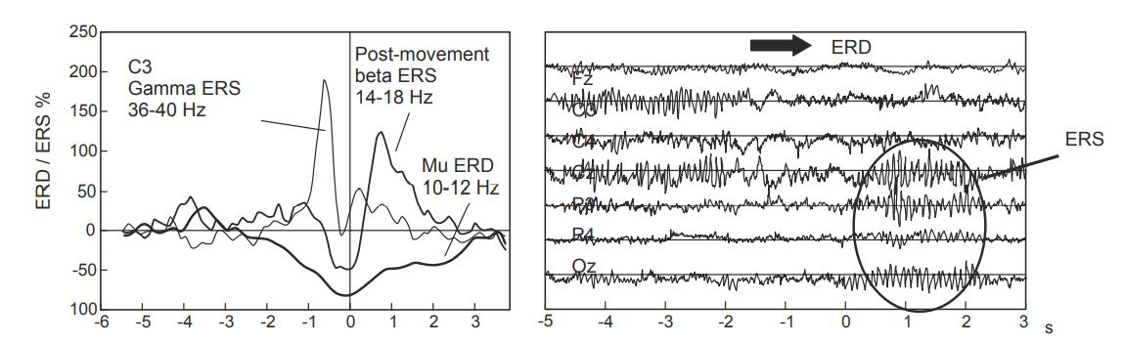
ERS,ERD Detection in picture(brisk finger movement)

Slide 9
Feature Extraction(data preprocessing)
PCA
ICA-removes ocular artifacts
GA,Common Spatial Pattern,Wavelet Transform,AR,Sequential Selection(DP approach),etc.

Slide 10
Artifacts
Signal Changes caused due to involuntary actions like irregular heartbeats, muscle twitches etc
Dealing with artifacts
Remove them
Reject them.

Slide 11
Classification of EEG data
K-NNC(K means algo)- Used for unsupervised dataset. Divides data into different classes by studying data patterns.
Bayesian analysis-Bayesian statistics method.
LDA- Linear Discrimnant Analysis. Simple for linear data. Not very helpful for high dimensional data.
SVM
ANN-Artificial neural Networks

Slide 12
Brain controlled Mobile Robots(EEG)
2 classes
Complete Manual Control
Control along with an Intelligent Agent(Automated Controller).It is Safer for the user.

Slide 13
5 steps
1st step- Suitable Brain Signals
P300?
SSVEP?
External Stimulus Required(Exogenous). So not very practical while making brain computer robots. No training required to use
ERD/ERS??
Requires training to use but endogenous and asynchronous so much better in the long run.

Slide 14
2nd Step- Signal Acquisition and Processing
Signal Acquistion- Depending on signal required(P300,SSVEPor ERD/ERS electrodes are placed on the scalp.
Signal preprocessing-Generally uses filters(high pass,low pass) to remove artifacts. This ends up removing signals at times. Also can use ICA/PCA but more complex.
Feature Extraction- 2 categories-
Time based(Temproal)-P300
Frequency based-ERD,SSVEP

Slide 15
Classifiers
LDA
ANN
Bayesian classifiers
SVM

Slide 16
Shared Control
Manual Switch Controlling-User divides when to give control to intelligent controller
Automatic Switch-Intelligent controller automatically takes control in predefined situations like obstacle avoidance.

Slide 17
In depth about classification algorithms
General properties of BCI signal
Noise and outliers
High dimensionality
Time information
Non-stationarity
Small training sets

Slide 18
Handle time variations
Concatenate features from different time segments into single vector
Combination of classifications at different time segments
Mainly first method is used
General Problems
Bias Variance tradeoff
High dimensionality

Slide 19
Linear apporaches
LDA
SVM

Slide 20
Neural Network Approaches
MultiLayer Perceptron-Most common neuron used in almost all types of DL problems
Need to study more about others
Learning Vector Quantization
Fuzzy ARTMAP
Dynamic Neural Network
RBF neural network
BLRNN(Bayesian Logistic Regression NN)

Slide 21
Bayesian Classifiers
Bayes quadratics
Hidden Markov Model
K-neighbour algorithm

Slide 22
Combination of Classifiers to Improve performance
Boosting. Several classifiers placed in serial connection . Sensitive to mislabels
Voting. Several classifiers are used. We take votes from each and select majority.
Stacking. Several level-0 classifiers. All results sent to level-1 classfier which gives final results.

Slide 23
Dataset-2a(BCI Competition 2008)
EEG data from 9 subjects
4 different motor imagery tasks-
Right hand
Left hand
Both feet
Tongue
2 sessions on different days
Session comprises of 6 runs separated by short breaks.
1 run consists of 48 trials(12 of each class)
Also EOG recording was done for 5 minutes in start to help remove EOG influence in EEG results.2 minutes eyes open,2 minutes eyes closed, one minute eye movement.

Slide 24
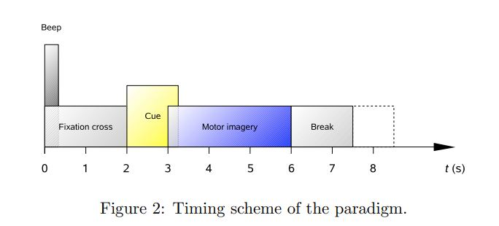
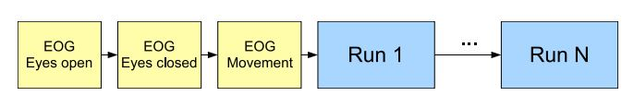

Slide 25
Data recording
22 Ag/AgCl electrodes
Signals sampled with 250 Hz and bandpass-filtered between 0.5Hz to 100Hz
EOG channels provided for artefact processing methods.

Slide 26
Data description
Each .gdf file consists entire data of one particular subject.
Training and evaluation data are separate.
Each run separated by 100 missing values
[s, h] = sload(’A01T.gdf’, 0, ’OVERFLOWDETECTION:OFF’);
s contains 25 channels- 22 EEG and 3 EOG
h.EVENT.TYP, h.EVENT.POS, h.EVENT.DUR.
Also h.ArtifactSelection contains a list of all trials, with 0 corresponding to a clean trial and 1 corresponding to a trial containing an artifact

Slide 27
Dataset 2b(very similar to dataset 2a)
Bandfilters and notchfilters same as dataset 2a
EOG included to help preprocess data
3 bipolar readings taken
2 classes – motor imagery of right and left hand
2 sessions without feedback ,6 runs, 10 trials of each class
3 sessions with feedback, 4 runs ,20 trials of each class.
In feedback sessions smiley face green for correct responses
Runs seperated by 100 missing values,NaN

Slide 28
Dataset 3(Directionally modulated MEG activity)
Subjects perform 4 different wrist movements
2 subjects
MEG at 625Hz
Move joystick from center to one of 4 targets using right hand and wrist
Bandpass filtered 0.5 to 100Hz and resampled to 400Hz
10 MEG channels

Slide 29
Dataset 4
ECoG recordings
Bandpass filtered 0.15 to 200Hz and sampled at 1000Hz
62,48 and 64 channels from subject 1,2 and 3 respectively
Subjects cued to move particular finger
Each cue subject move particular finger 3-5 times
30 movement stimulus cues for each finger
Train_data 6mins 40 secs of ECoG of each channel (time)X(channels).
Train_dg which finger was moved timeXfinger
Test_data 3 mins 20 secs of ECoG for prediction.

Slide 30
Implemented Code- Support Vector Machines
Classification Algorithm
Uses a hyperplane in high dimensions to linearly separate data.
Kernel Functions used to project data in a higher dimension than dimensionality of the data
Both analytic and numerical solutions possible.
Hard Margin and Soft margin classification

Slide 31
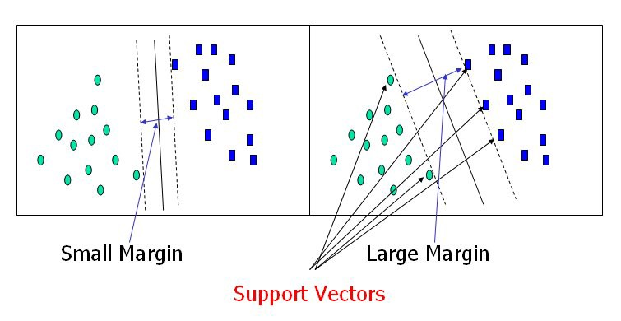

Slide 32
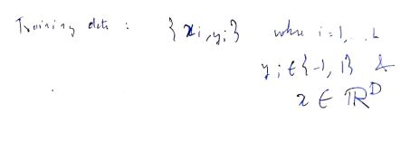

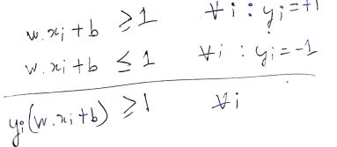
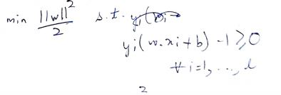
Equations- SVM
Optimization is done using analytic methods like Lagrange Multipliers and numeric methods like Gradient Descent.

Slide 33

Implemented Code- SVM
SVM implemented from scratch
Analytic method with help of quadprog function for optimization.
Kernels added : radial basis function and polynomial
Soft Margin classification

Slide 34
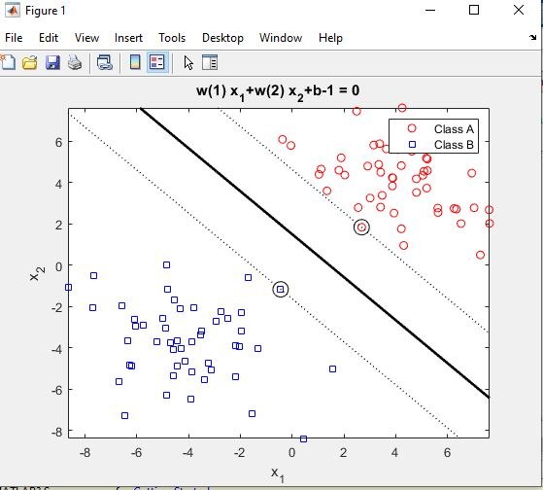
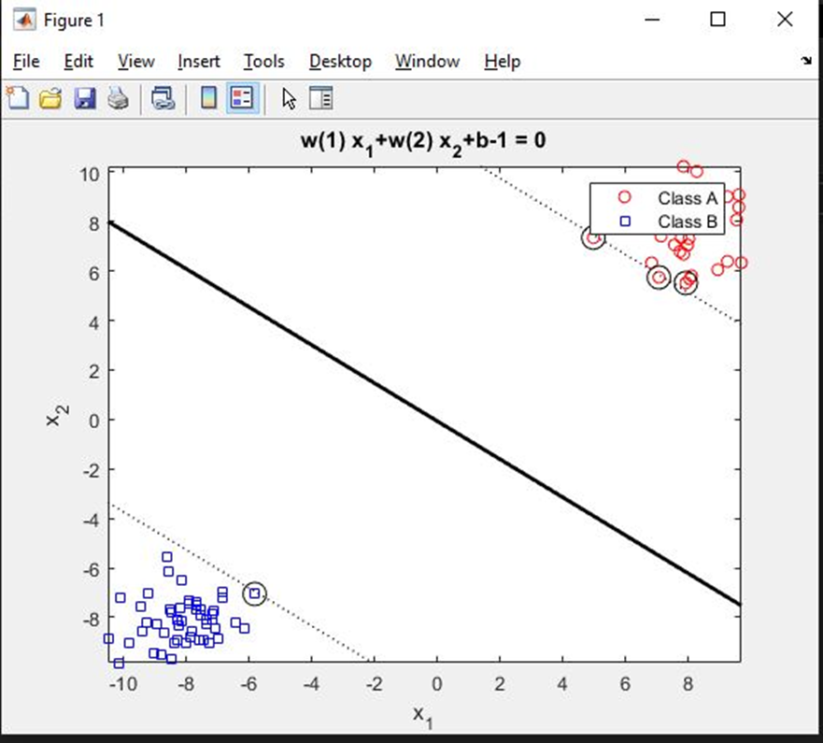
Linearly Separable Data

Slide 35
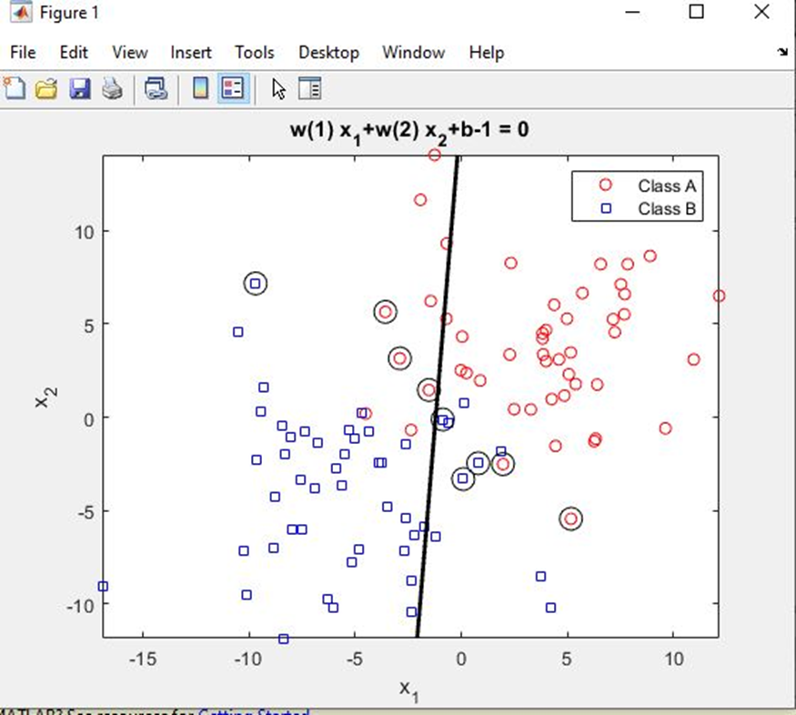
Linearly Inseparable Data

Slide 36
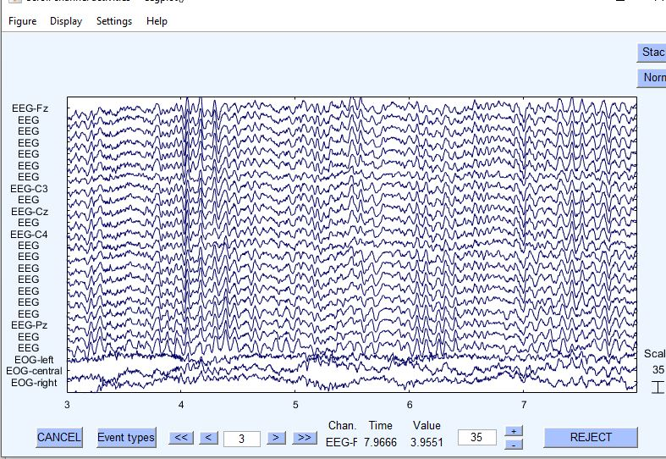
EEG dataset 2a plot. Along with EOG channels

Slide 37
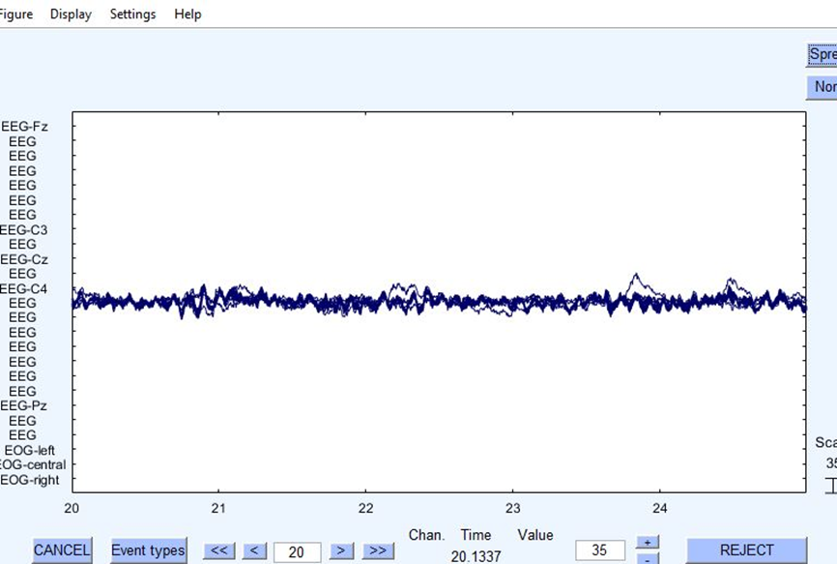
Stacked Channels Plot

Slide 38
Feature Extraction
3 main sources of information
Spatial Information: Origin of signals from specific spatial regions of brain.
Spectral Information: Variation in power in specific feature bands
Temporal Information: Variation of signal with time.
For motor imagery classification mainly spatial and spectral information are important.
Spatial Filtering: Linear combination of small number of spatially close channels. This decreases smearing effect of skull.eg – Laplacian and Bipolar(Neurophysiological significance) and data driven filters.

Slide 39
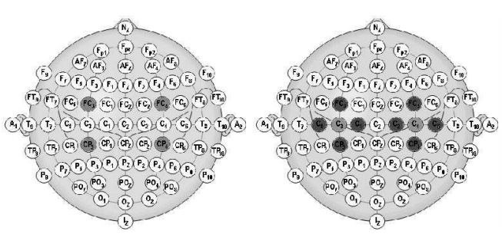

Slide 40
Signal Plot
A channel represents the position of an EEG electrode.
Different spatial positions give different information
Eg- Channel C3 and C4 represent right and left hand motor activity respectively. Cz represents foot movement.
Functions to plot each channel were written.

Slide 41
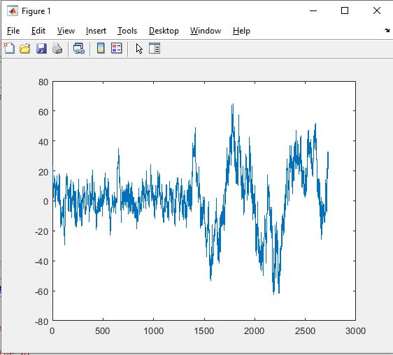
Magnified image of channel 3

Slide 42
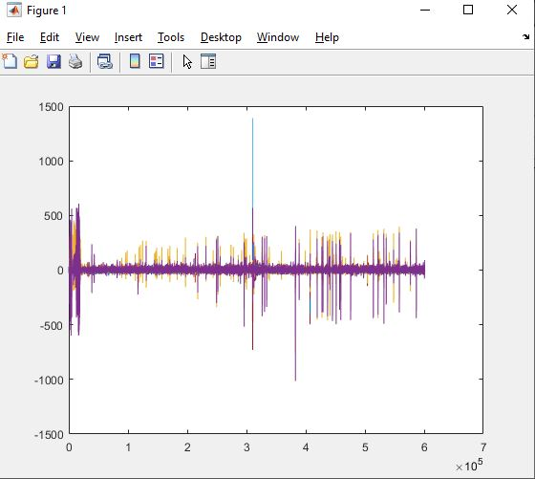
Plot of all the channels

Slide 43
Discrete Fourier Transformation
Widely used tool in signal processing
Breaks down a signal into sinusoidal waves that can be superimposed to reconstruct the original signal.
The Y axis plot the amplitude of wave and X axis plots the frequency.
Fast Fourier Transformation was used to calculate DFT.

Slide 44
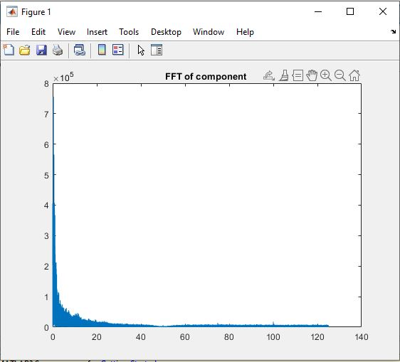
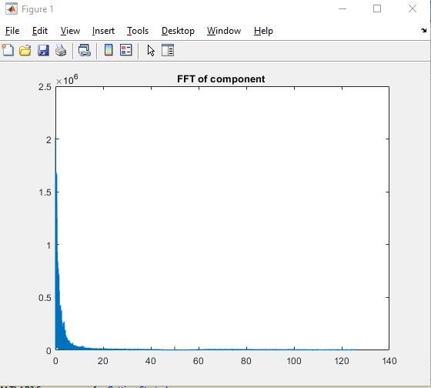
FFT of component 1 and 25

Slide 45
Discrete Cosine Transformation
Used for Compression of signal.
Uses real cosines unlike DFT that uses complex sinusoidals.
DCT decomposed signal as a superposition of real cosine waves with coefficients. Coefficients with small values are set to 0 and discarded compressing the signal.

Slide 46
Manual Feature Extraction
All the DFT,DCT and signal plots were compared manually and the ones that best differentiate the classes were selected
These were created into a feature vector used for Classification.
Channels :1,3,6,11
FFT Channels: 1,6
DCT Channels : 1,6

Slide 47
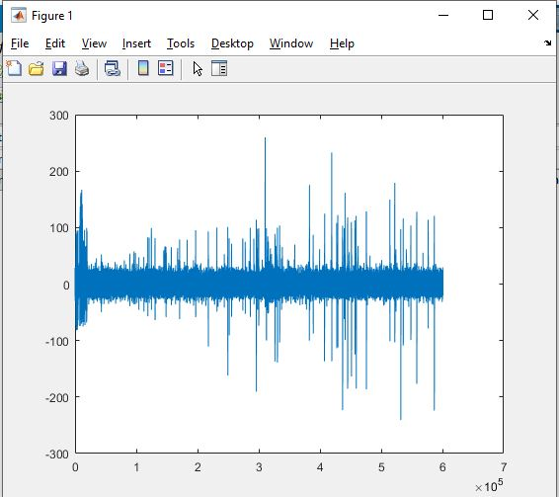
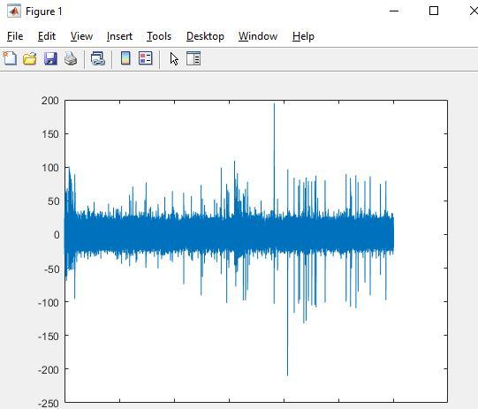
Signal Plots: Channel 1 and 3

Slide 48
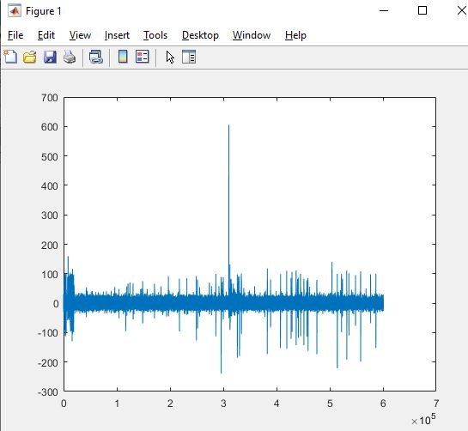
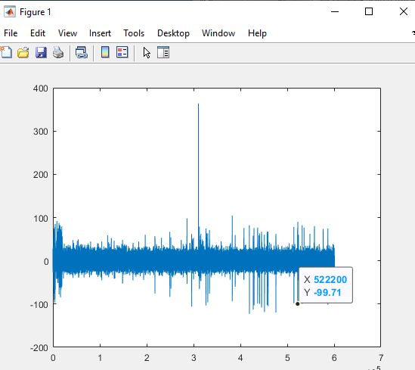
Signal Plots: Channel 6 and 11

Slide 49
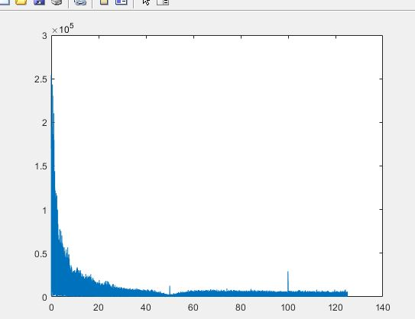
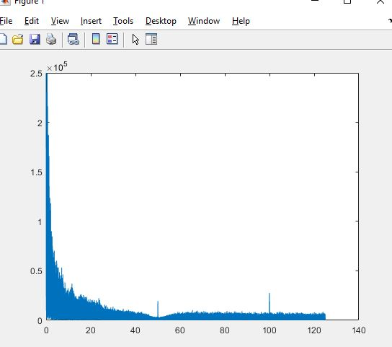
FFT : Channel 1 and 6

Slide 50
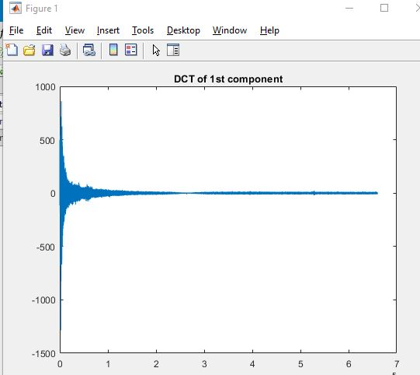
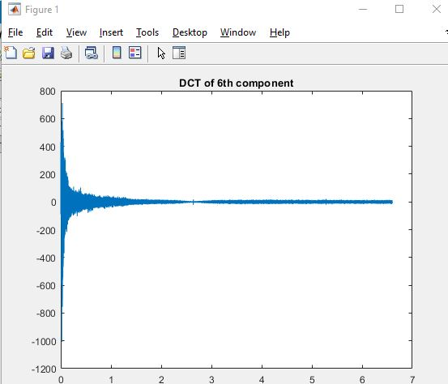
DCT : Channel 1 and 6

Slide 51
Final Feature Extraction
Power-spectra with log scale
Single-Channel Spatial Cognitive Patterns
Gray Level Co-Occurrence Matrix

Slide 52


Power Spectra with log scale.
Power spectrum intuitively means how much of signal is at a frequency f.
DFT of signals are taken and the absolute value of amplitudes at different frequencies are used.
They are converted into the log10 scale.

Slide 53


Single Channel Spatial Cognitive Patterns(SC-CSP)
CSP finds spatial filters such that the variance of the filtered signal is maximal for one class and minimal for the other.
In motor imagery classification , EEG signals are filtered in 8-30 Hz band before being spatially filtered with CSP.
Helps improve classification performance

Slide 54
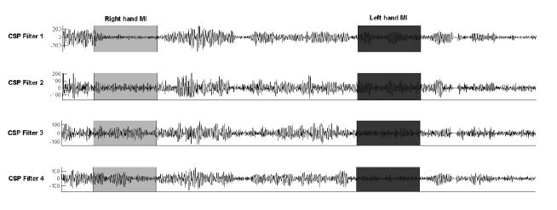
CSP Filters eg

Slide 55
SVM with radial basis function
Results:
Training Accuracy= 67.8571
Testing Accuracy=60.7143

Slide 56
Optimization For SVMs- Genetic Algorithm
Search Heuristic inspired by Darwin’s theory of evolution.
Method for solving both constrained and unconstrained optimization problem
Converts the search space into a genotype space(binary space).
Evolution occurs in genes in the form of mutation ,crossover and selection of the fittest.
The genetic algorithm was used as an optimizer for the support vector machine problem.

Slide 57
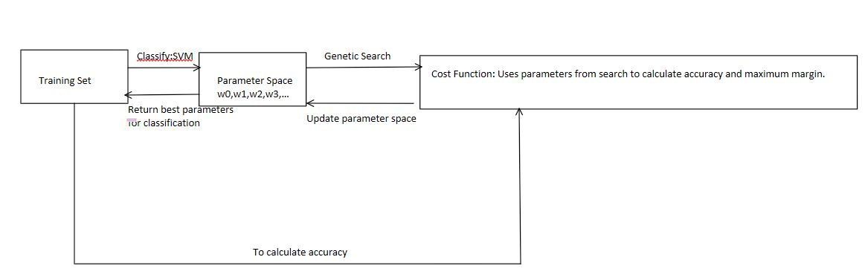
Flow

Slide 58
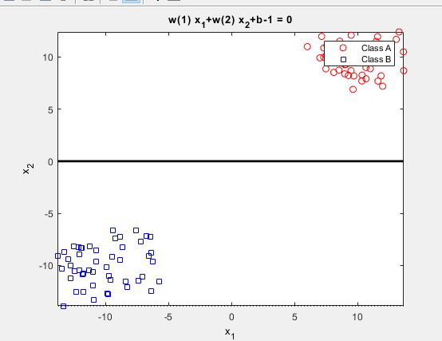
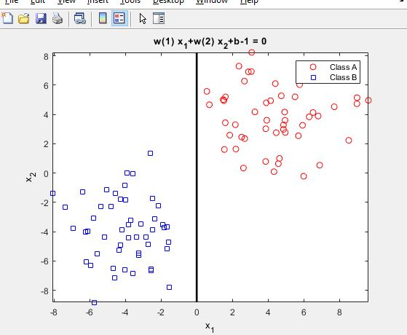
SVM with GA : Linearly separable data

Slide 59
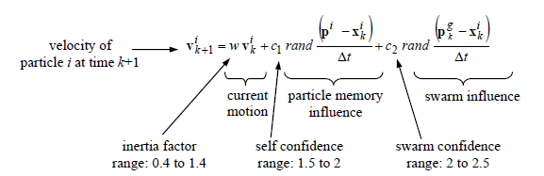
Optimization For SVMs- Particle Swarm Optimization
Heuristic global optimization technique
Population based search algorithm based on simulation of social behaviour of birds.
Influenced by personal and global best

Slide 60
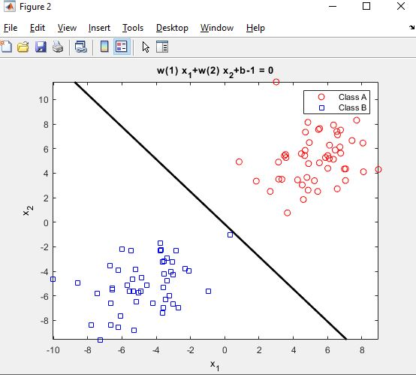
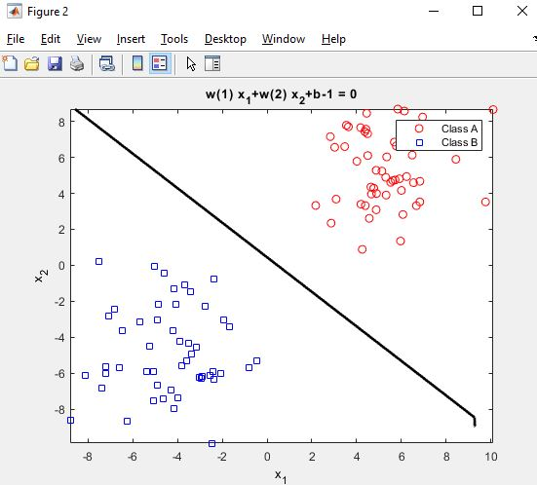
SVM-PSO with linearly separable data

Slide 61
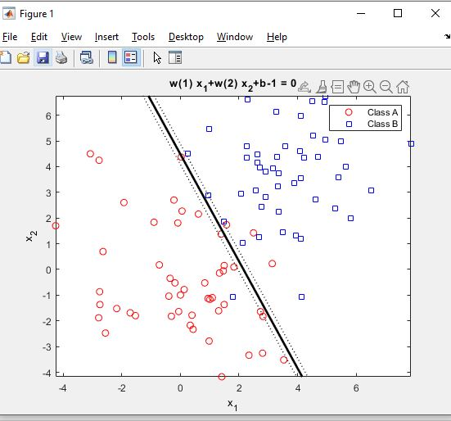
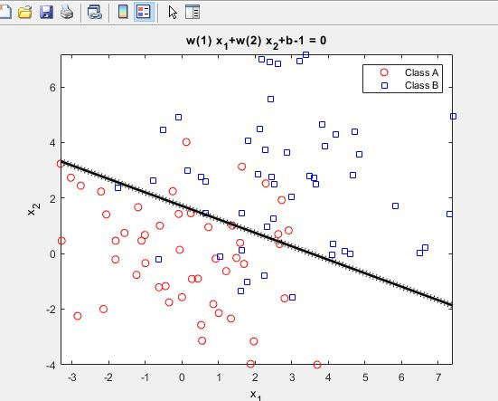
SVM-PSO non linear data

Slide 62
SVM-PSO with BCI data
Hyperparameters:
Agents=100
Generations=10000
Training Accuracy=0.6056
Testing Accuracy=0.5417

Slide 63
Conclusion
BCI datasets contain raw signals that require a lot of signal preprocessing and feature extraction
Signal preprocessing is done using artefact removal and bandpass filtering.
Feature Extraction can be done using CSP and power spectra methods
Classification was done using a variety of different Support Vector Machines.
The code written for Feature extraction can be used for various BCI motor imagery classification datasets.
The code written for SVMs along with feature extraction can be used for many different motor imagery datasets.
The experiments with SVM show that with state of the art feature extraction and training testing along with good datasets SVM can be used for classification in real world online products

Slide 64
Future Scope
SVMs can be tested with different datasets
The feature extraction vector can be used with other classification algorithms like ANNs and LDAs.
An inter-user classification can be done with SVMs to research how adaptable SVMs classifications are and if a universal classifier can be made instead of training the classifier specific to the user.

Slide 65
References
Nicolas-Alonso, Luis Fernando, and Jaime Gomez-Gil. "Brain computer interfaces, a review." Sensors 12.2, 1211-1279 (2012).
Bi, Luzheng, Xin-An Fan, and Yili Liu. "EEG-based brain-controlled mobile robots: a survey." IEEE transactions on human-machine systems 43.2, 161-176 (2013).
Lotte, Fabien, Marco Congedo, Anatole Lécuyer, Fabrice Lamarche, and Bruno Arnaldi. "A review of classification algorithms for EEG-based brain–computer interfaces." Journal of neural engineering 4, no. 2 (2007)
H Cecotti, Hubert, and Axel Graser. "Convolutional neural networks for P300 detection with application to brain-computer interfaces." IEEE transactions on pattern analysis and machine intelligence 33.3, 433-445 (2011)
Lu, Na, Tengfei Li, Xiaodong Ren, and Hongyu Miao. "A deep learning scheme for motor imagery classification based on restricted boltzmann machines." IEEE transactions on neural systems and rehabilitation engineering 25, no. 6, 566-576 (2016).

